Slide 1
Querying Arrays & Sorting & Limiting

Slide 2

MongoDB $size operator
The $size is an array query operator that allows you to select documents that have an array containing a specified number of elements.
The $size operator has the following syntax
In this syntax, you specify the element_count after the $size operator to match all documents where the array_field has exact element_count elements

Slide 3
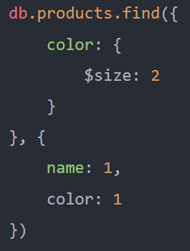
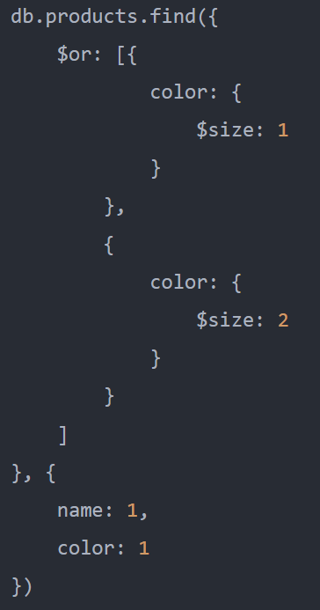
MongoDB $size operator - Example
The following example uses the $size operator to select documents whose color array has two elements
The following example shows how to use $size operator with the $or operator to select documents whose the color array has one or two elements

Slide 4

MongoDB $all operator
The $all is an array query operator that allows you to find the documents where the value of a field is an array that contains all the specified elements.
The $all operator has the following syntax
$all and $and
The following expression that uses the $all operator
is equivalent to the following expression that use the $and operator

Slide 5
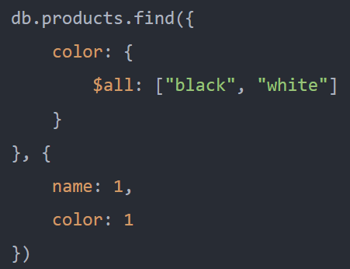
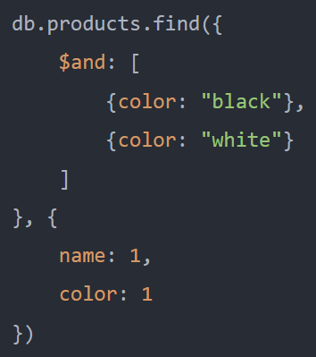
MongoDB $all operator - Example
the above query is equivalent to the following query that uses the $and operator:

Slide 6
MongoDB $elemMatch operator
The $elemMatch is an array query operator that matches documents that contain an array field and the array field has at least one element that satisfies all the specified queries.
The $elemMatch has the following syntax.
In this syntax:
First, specify the name of the array field.
Second, specify a list of queries that you want at least one element in the <arrayField> to meet the query criteria

Slide 7
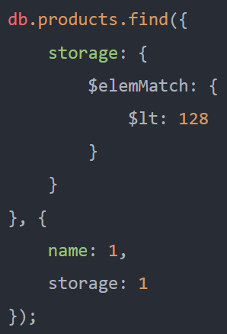
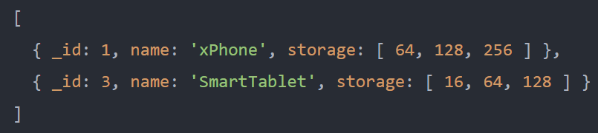
MongoDB $elemMatch operator - Examples
It matches the documents where the storage is an array that contains at least one element less than 128

Slide 8
Sorting & Limiting

Slide 9



MongoDB sort() method
To specify the order of the documents returned by a query, you use the sort() method
The sort() method allows you to sort the matching documents by one or more fields (field1, field2, …) in ascending or descending order.
The order takes two values: 1 and -1.
If you specify { field: 1 }, the sort() will sort the matching documents by the field in ascending order:
If you specify { field: -1}, the sort() method will sort matching documents by the field in descending order

Slide 10
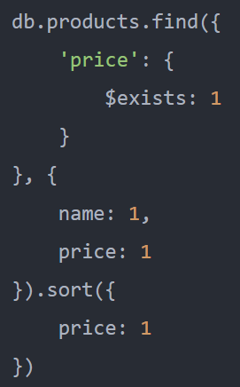
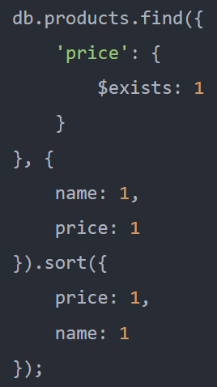
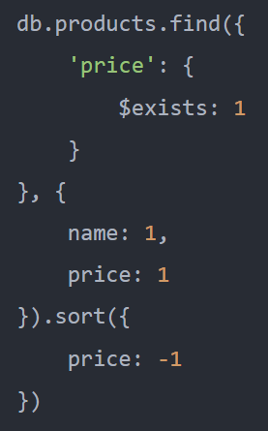
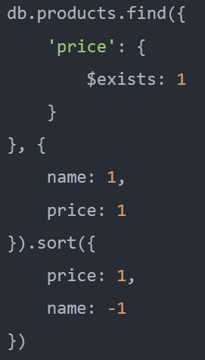
MongoDB sort() method - Examples

Slide 11
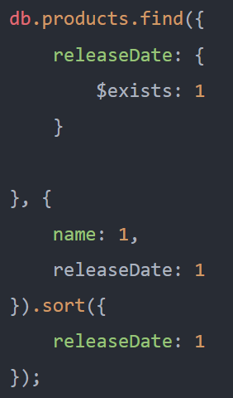
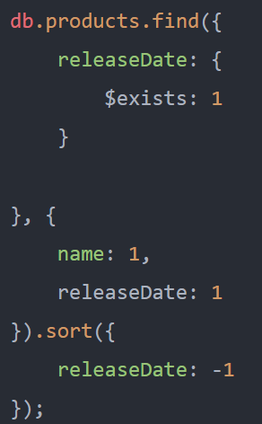
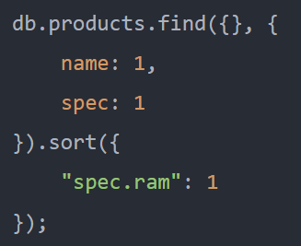
MongoDB sort() method - Examples

Slide 12
MongoDB limit() method
The find() method may return a lot of documents to the application. Typically, the application may not need that many documents.
To limit the number of returned documents, you use the limit() method.
The <documentCount> is in the range of -231 and 231. If you specify a value for the <documentCount> that is out of this range, the behavior of the limit() is unpredictable.
If the <documentCount> is negative, the limit() returns the same number of documents as if the <documentCount> is positive. In addition, it closes the cursor after returning a single batch of documents.
If the result set does not fit into a single batch, the number of returned documents will be less than the specified limit.
If the <documentCount> is zero, then is equivalent to setting no limit.
Note that the limit() is analogous to the LIMIT clause in SQL.

Slide 13
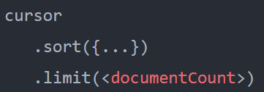

MongoDB limit() method
To get the predictable result set using the limit(), you need to sort the result set first before applying the method like this
In practice, you often use the limit() with the skip() method to paginate a collection.
The skip() method specifies from where the query should start returning the documents

Slide 14
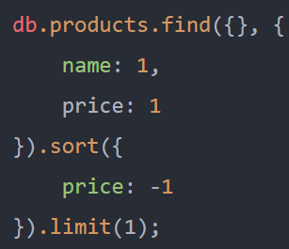
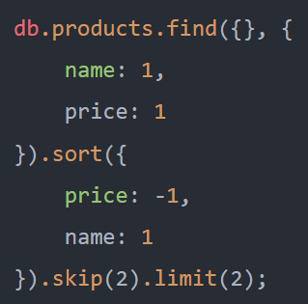
MongoDB limit() method - Examples
The following example uses the limit() method to get the most expensive product in the products collection. It includes the _id, name, and price fields in the returned documents
Suppose you want to divide the products collection into pages, each has 2 products.
The following query uses the skip() and limit() to get the documents on the second page

